Slide 1
Chapter 2.4
Rates, Ratios, and Proportions

Slide 2
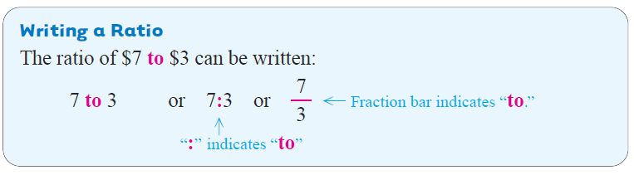
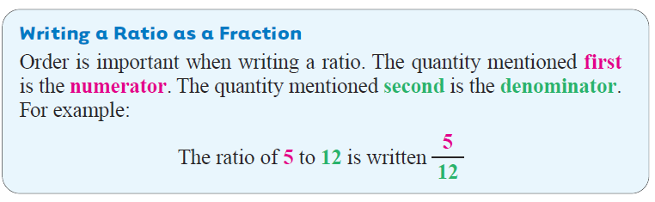
A ratio compares two quantities.

Slide 3
Parallel
Example 1
Writing Ratios
Tamara spent $13 on fish, $8 on salad and $7 on bread. Write each ratio as a fraction.
a. Ratio of amount spent on salad to amount spent on bread.
The ratio of salad to bread is
b. Ratio of fish to bread.
Numerator
(mentioned first)
Denominator
(mentioned second)

Slide 4
Parallel
Example 2
Writing Ratios in Lowest Terms
Write each ratio in lowest terms.
a. 80 days to 20 days.
Divide the numerator and denominator by 20.
b. 30 ounces of medicine to 140 ounces of medicine

Slide 5
Parallel
Example 3
Using Decimal Numbers in a Ratio
The price of a bag of dog food increased from $22.95 to $25.50. Find the ratio of the increase in price to the original price.
Find the ratio of the increase in price to the original price.
Now write the ratio as a ratio of whole numbers.
new price – original price = increase
$25.50 − $22.95 = $2.55

Slide 6
Parallel
Example 4
Using Mixed Numbers in Ratios
Write each ratio as a comparison of whole numbers in lowest terms.
4 days to
Write the ratio and divide out common units.
Write as improper fractions.
Reciprocals

Slide 7
Parallel
Example 4
Using Mixed Numbers in Ratios
b.

Slide 8
Parallel
Example 1
Writing Rates in Lowest Terms
Write each rate as a fraction in lowest terms.
a. 8 gallons of antifreeze for $40.
b. 192 calories in 6 ounces of yogurt
Slide 5.2- 8

Slide 9
Parallel
Example 1
continued
Writing Rates in Lowest Terms
Write each rate as a fraction in lowest terms.
c. 84 hamburgers on 7 grills.
Slide 5.2- 9

Slide 10
When the denominator of a rate is 1, it is called a unit rate. For example, you earn $16.25 for 1 hour of work.
This unit rate is written:
$16.25 per hour
Use per or a slash mark (/) when writing unit rates.
Slide 5.2- 10

Slide 11
Parallel
Example 2
Finding Unit Rates
Find each unit rate.
a.
445.5 miles on 16.5 gallons of gas
Divide to find the unit rate.
The unit rate is 27 miles per gallon or 27 miles/gallon.
Slide 5.2- 11

Slide 12
Parallel
Example 2
continued
Finding Unit Rates
Find each unit rate.
b.
413 feet in 14 seconds
Divide to find the unit rate.
The unit rate is 29.5 feet/second.
Slide 5.2- 12

Slide 13
Parallel
Example 3
Determining the Best Buy
A local store charges the following prices for jars of jelly.
$3.09
$3.69
$2.39
18 oz.
24 oz.
28 oz.
The best buy is the container with the lowest cost per unit. All the jars are measured in ounces. Find the cost per ounce for each one by dividing the price of the jar by the number of ounces in it. Round to the nearest thousandth if necessary.
Slide 5.2- 13

Slide 14
Parallel
Example 3
continued
Determining the Best Buy
Size | Cost per Unit (rounded)
18 ounces
24 ounces
28 ounces
highest
lowest
The lowest cost per ounce is $0.129, so the 24-ounce jar is the best buy.
Slide 5.2- 14

Slide 15
Parallel
Example 4
Solving Best Buy Applications
Juice is sold as a concentrated can as well as in a ready to serve carton. Which of the choices below is the best buy?
12 oz can makes 48 ounces of juice for $1.69
60 oz carton for $2.59
To determine the best buy, divide the cost by the number of ounces.
Slide 5.2- 15

Slide 16
Parallel
Example 4
continued
Solving Best Buy Applications
12 oz can makes 48 ounces of juice for $1.69
60 oz carton for $2.59
Concentrate
$0.0352 per ounce
Carton
$0.0432 per ounce
Although, you must mix it yourself, the concentrated can of juice is the better buy.
Slide 5.2- 16

Slide 17
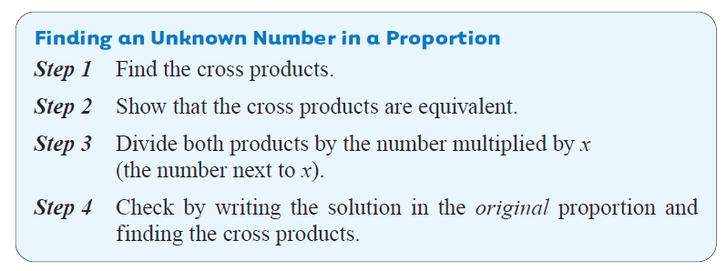
Four numbers are used in a proportion. If any three of these numbers are known, the fourth can be found.

Slide 18
Parallel
Example 1
Solving Proportions for Unknown Numbers
Find the unknown number in each proportion. Round answers to the nearest hundredth when necessary.
a.
Ratios can be written in lowest terms. You can do that before finding the cross products.
can be written in lowest terms as , which gives the proportion

Slide 19
Parallel
Example 1
continued
Solving Proportions for Unknown Numbers
Step 1
Find the cross products
Step 2
Show that the cross products are equivalent.
1
Step 3
1
Slide 5.4- 19

Slide 20
Parallel
Example 1
continued
Solving Proportions for Unknown Numbers
b.
Step 1
Find the cross products
Step 2
Show that the cross products are equivalent.
1
Step 3
1
Rounded to the nearest hundredth.
Slide 5.4- 20

Slide 21
Parallel
Example 2
Solving Proportions with Mixed Numbers and Decimals
Find the unknown number in each proportion.
a.
Find the cross products
Find
12
1
Show the cross products are equivalent.
Divide both sides by 8.
Slide 5.4- 21

Slide 22
Parallel
Example 2
continued
Solving Proportions with Mixed Numbers and Decimals
Equal
The cross products are equal, so 30 is the correct solution.
Slide 5.4- 22

Slide 23
Parallel
Example 2
continued
Solving Proportions with Mixed Numbers and Decimals
Find the unknown number in each proportion.
b.
Show that cross products are equivalent.
Divide both sides by 10.4.
Slide 5.4- 23

Slide 24
Parallel
Example 2
continued
Solving Proportions with Mixed Numbers and Decimals
10.4 ∙ 8.06 = 83.824
Equal
12.4 ∙ 6.76 = 83.824
The cross products are equal, so 8.06 is the correct solution.
Slide 5.4- 24

Slide 25
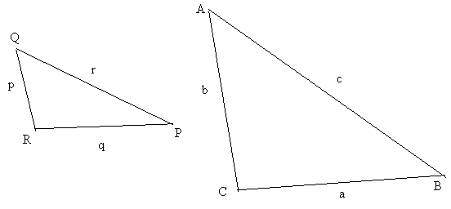
Similar Triangles
Similar Triangles whose angles have the same measure, but their sides have different lengths.
The triangles will look identical, but one will be smaller than the other.

Slide 26
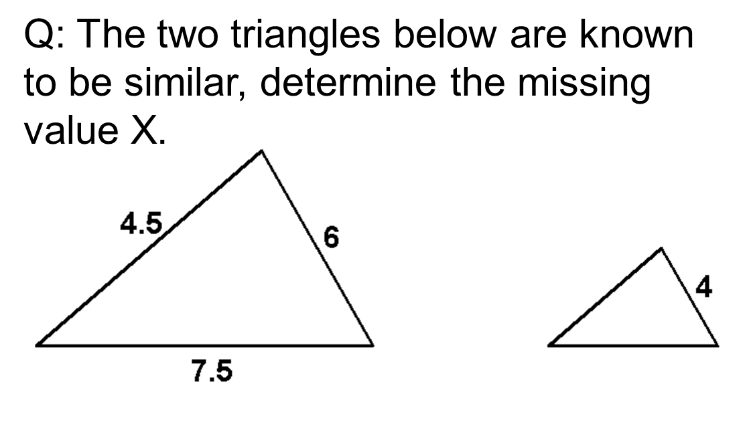

$\frac{r}{c}=\frac{p}{b}=\frac{q}{a}$
x
y

Slide 27
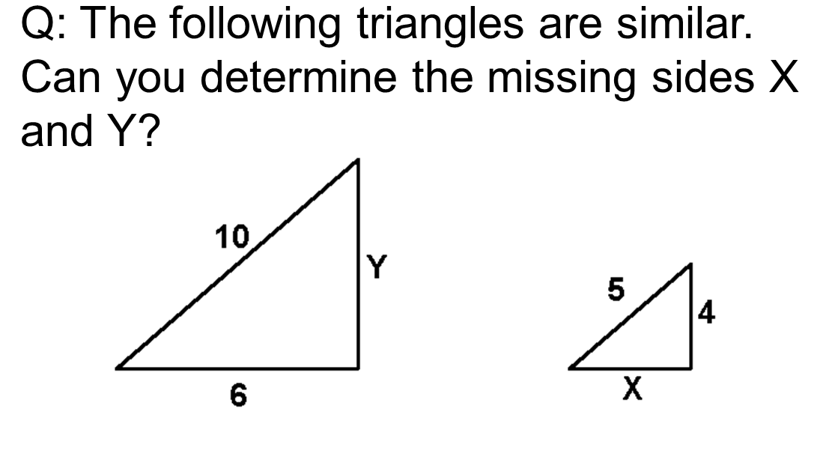

Slide 28
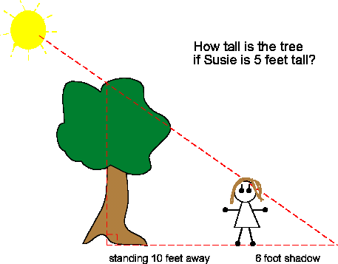

Slide 29

Solution
$$\frac{Your Height}{Tree Height}= \frac{Your Shadow Length}{Tree shadow length}$$

Slide 30
Hw section 2.4
1-20
Try 21

